Slide 1
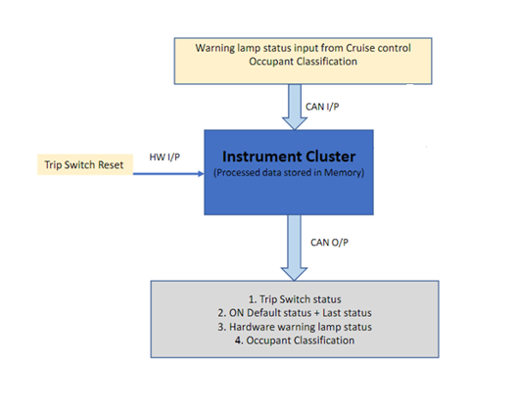
Project Name :
Instrument Cluster
Cruise Control
Occupant
Classification
LED 3 System warning lamp
SW 1
LED 4 Trip RESET switch status
SW 2
LED 2 Cruise Control node status
LED 1 Occupant classification Status
Project Members :
Siddeshwar
Praveen
Vishwanath

